Slide 1

Mental Health, SEL, & Restorative Practices Simplified
Strategies You Can Start Using Tomorrow
Greg Hickey, LPC

Slide 2
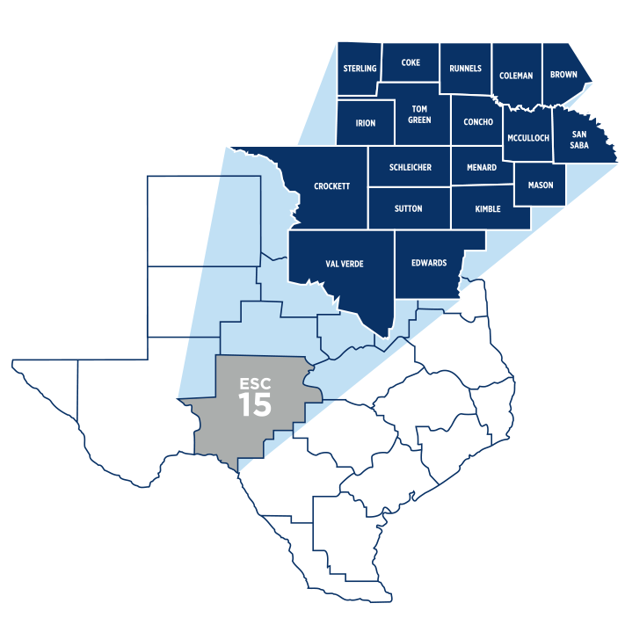
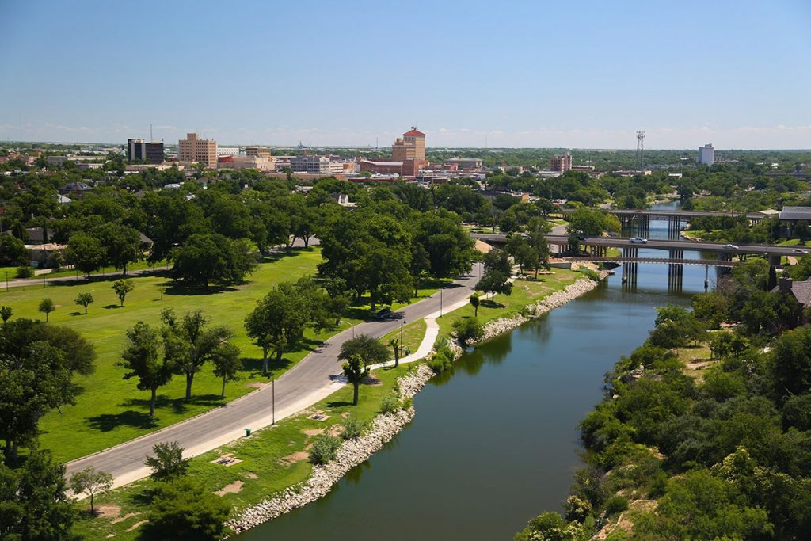
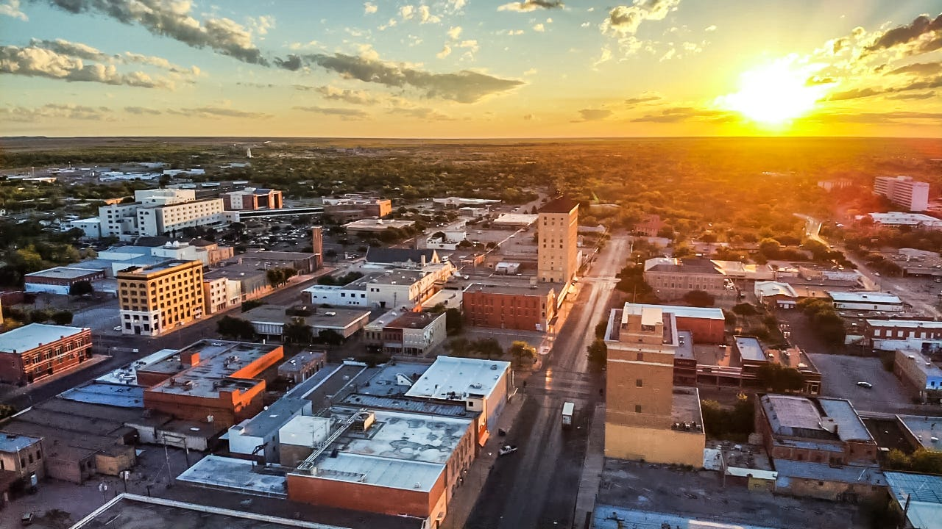
ESC 15 in San Angelo, TX

Slide 3
What are we talking about today?
A little bit of theory…
  Key concepts in SEL & Restorative Practice
  A mindset shift: what works, what doesn’t, and why
  Underpinnings of challenging behavior
…and a lotta bit of strategy!
  SEL/restorative practices
  Tightening our communication

Slide 4
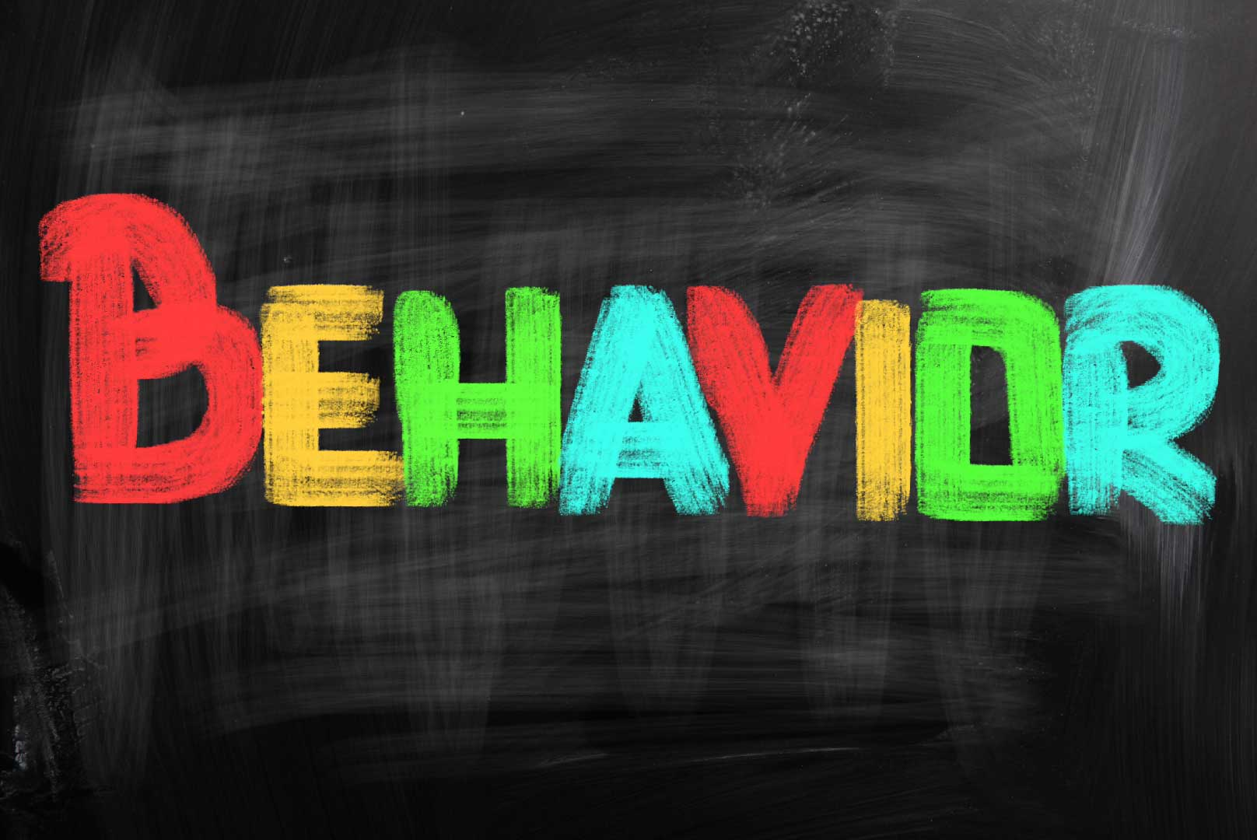
WHAT LIES BENEATH THE
?
A brief biopsychosocial perspective…

Slide 5

In a class of 30 high school seniors…
Adverse Childhood Experiences (ACEs) and mental health challenges play a role
5 have considered suicide; 4-5 have planned; 3 have attempted
7 experienced some kind of significant mental health challenge
8 have been physically abused; 6 have been sexually abused
7 are children of divorce
4 have witnessed domestic violence in the home

Slide 6
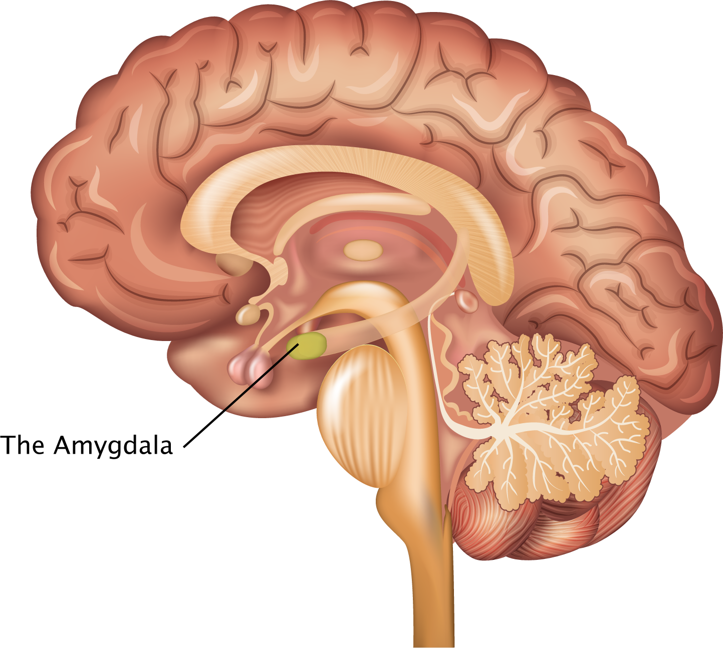
We all come equipped with a “threat alarm”
Pre-frontal cortex
The amygdala senses threat and sets off the “alarm”
Pre-frontal cortex goes offline; emotional brain activates fight or flight
Pre-frontal cortex helps shut off the alarm and helps us to calm down
Threats can be physical and psychological!

Slide 7
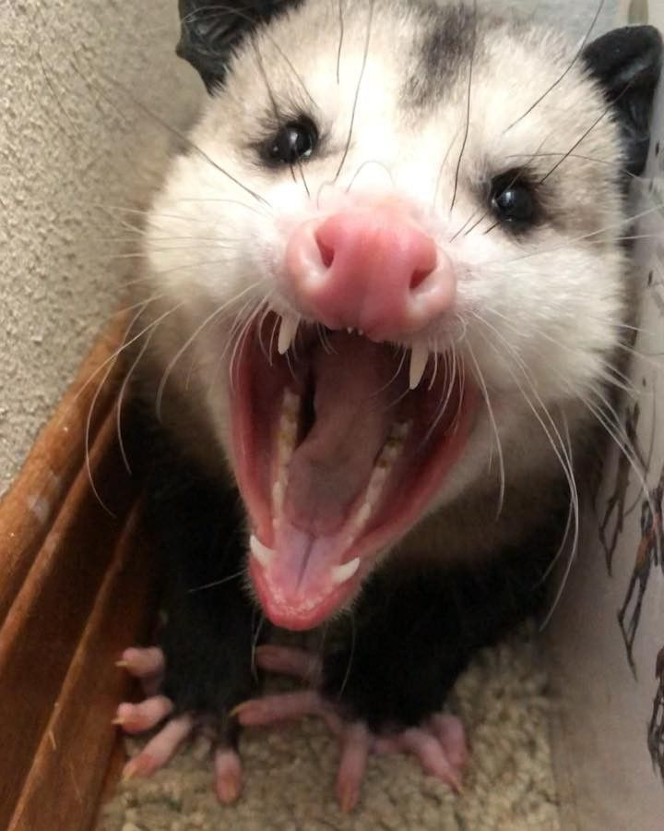
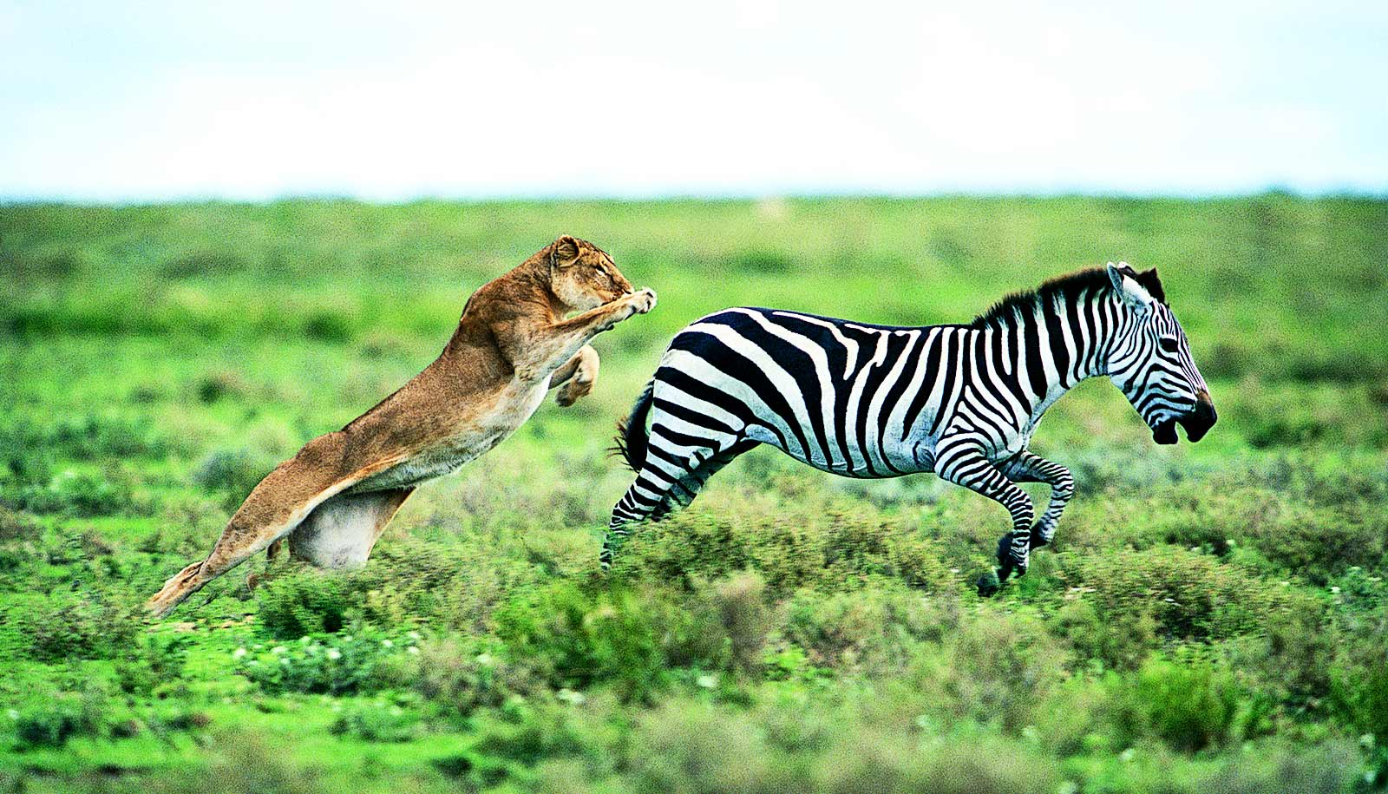

Trauma is Different…
An event becomes traumatic when we feel physically and psychologically threatened, our stress response/coping systems are overwhelmed, and we experience lasting effects
Fight responses: yelling, swearing, posturing, aggressive behavior
Flight responses: fibbing, running away, refusing to talk, avoidance, substances
Freeze responses: spacing out; appearing numb, disconnected, confused, unresponsive

Slide 8
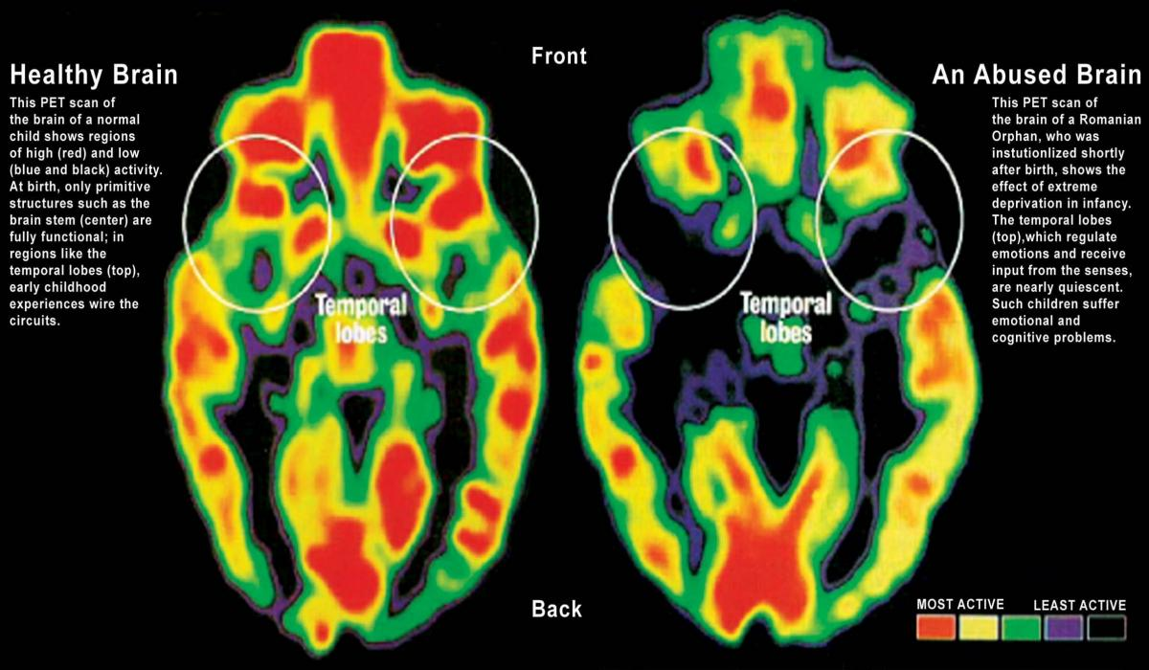
What is “complex trauma?”
The term complex trauma refers to exposure to multiple traumatic events from an early age, and the immediate and long-term effects of these experiences over development.
Notes:
Presenters should review the concept of complex trauma and then ask participants to consider whether the see this type of trauma among their students.
The term complex trauma describes both exposure to multiple traumatic events from an early age and the immediate and long term effects of these experiences over the course of development.
Examples include chronic abuse, neglect, or exposure to family violence, as well as other forms of violent victimization experienced from an early age without adequate adult support to manage these experiences. This type of trauma is particularly devastating because it occurs during critical periods of brain development, before a child has had the chance to develop strong, positive ways to cope with stress.
Youth with complex trauma are likely to exhibit a range of behavioral and academic difficulties that require additional intervention by adults in the school community. We will talk more about what this looks like in Part 3 of this training.
Citations:
National Child Traumatic Stress Network. (2014). Complex trauma: Facts for educators. Los Angeles, CA, & Durham, NC: National Center for Child Traumatic Stress.
Cook, A., Spinazzola, J., Ford, J., Lanktree, C., Blaustein, M., Cloitre, M., . . . van der Kolk, B. (2005). Complex trauma in children and adolescents. Psychiatric Annals, 35(5), 390–398.
National Child Traumatic Stress Network . (n.d.). Complex Trauma. Retrieved from http://www.nctsnet.org/trauma-types/complex-trauma

Slide 9
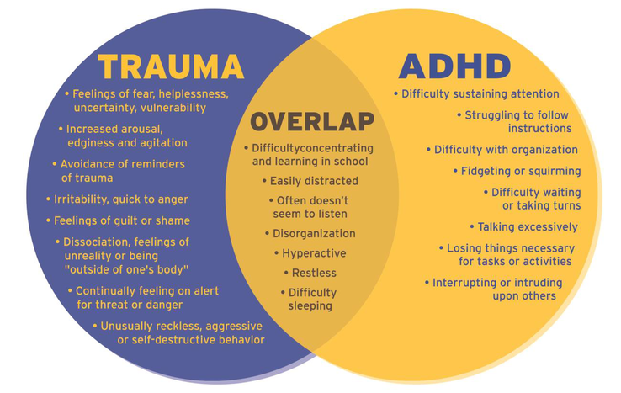
What’s wrong with this kid?! vs What’s happened to this kid?
Ref: The National Child Traumatic Stress Network, 2016

Slide 10
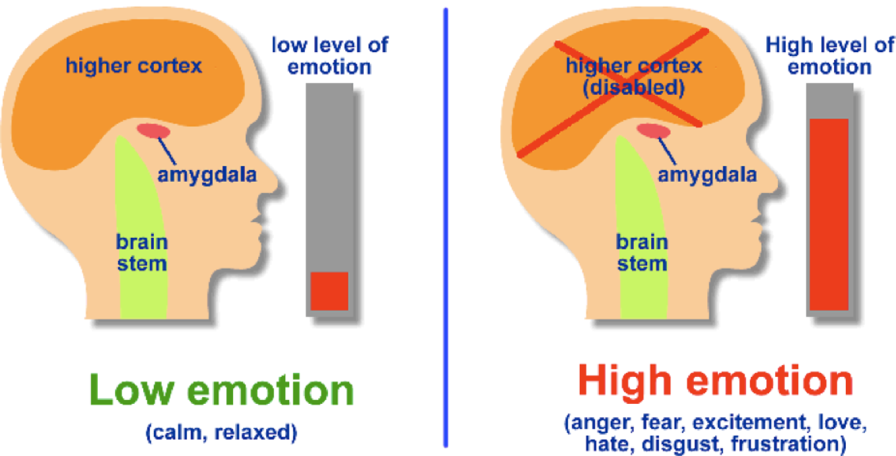
When the child is reacting, think to yourself:
“This kid’s brain just isn’t where it needs to be in order to have a productive conversation!”
…and…
“They may have a lot less control right now than I think they do…”

Slide 11

Getting Practical:
SEL/Restorative Strategies

Slide 12
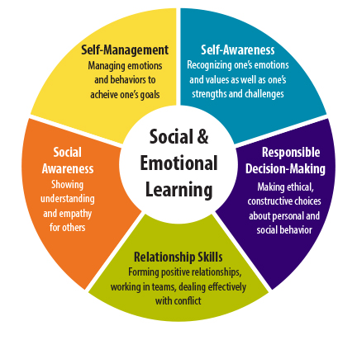
What is Social & Emotional Learning (SEL)?

Slide 13
The Five Rs of Restorative Practice
Respect
  All parties interested in repairing the problem and willing to respect one another’s insights and experiences
Relationships
  Human issues are relatable; allow all parties to hear one another’s side of the story
Responsibility
  All involved own-up to their actions and possible consequences
Repairing Harm
  Exclusive punishments vs. meaningful consequences
Reintegrating
  Taking a moment to calm down, agreeing to follow-up at a later time, getting back to routine

Slide 14
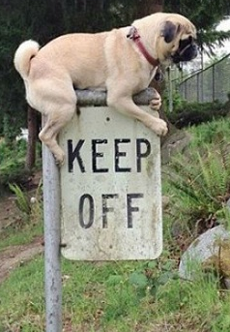
Defining Community Expectations
Essential for a restorative classroom; also ties into SEL
Rules = “Thou shalt not!”
Expectations = “What we owe each other, ourselves, our teacher, our space…”
One expectation can cover dozens of rules
  “We respect other people’s bodies and space.”
  “We respect each other’s right to their point of view.”
  “We say and do kind things in this classroom.”
  “We respect our learning space and keep it clean/orderly.”

Slide 15
Expectation-Setting as a Democratic Process:
What kind of environment do you need to do your best learning?
Think about the best class you’ve ever been in:
  What was it about the other students that helped make it great?
  What was it about the teacher?
  What were your interactions like with your fellow students?
Now, think about the worst class you’ve ever been in:
  What got on your nerves?
  What was it about the other students, teacher, interactions that made it worse?
Video (little learners): https://www.youtube.com/watch?v=f_CmjJoEzfc

Slide 16
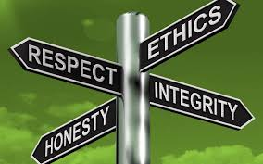
Help students define their values:
Ask students about someone they admire/want to be more like
  What about them do they admire? What qualities do they possess? Make a list…
“If you were to move tomorrow…how would you want people to remember you?” Make a list of these qualities, too…
Narrow this list down to 3 to 5 qualities
Host a class discussion/circle
  What can you do to move you toward these qualities?
Can we post these somewhere? Put them on our folders?

Slide 17
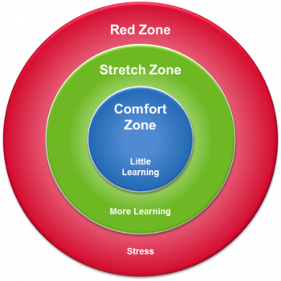
Zones of Growth: Defining Our Comfort Levels
Introduce the three Zones of Growth to your students:
  The Comfort Zone: low-stress and familiar
  The Challenge/Stretch Zone: uncomfortable, bearable, and on its way to the comfort zone
  The Crisis/Panic/Red Zone: wrought with anxiety, fear, and fight/flight/freeze reactions
Get them up and moving!
  Define these zones in your classroom (or meeting area)
  Have everyone start in the comfort zone
  Move to your comfort zone for______________

Slide 18
Zones of Growth, Continued…
Important questions to ask during the activity and as needed when learning:
  What do you notice that tells you you’re in the comfort, challenge, or crisis zone?
  What could you do to become more comfortable with this?
  What small steps can you take to become more comfortable, but not so stressed that you move into the crisis zone?
  What is something you’d love to do in this area if you weren’t so anxious/afraid?
  What shouldn’t you do to stay out of the crisis zone?
  What can you do to gently push yourself outside the comfort zone?

Slide 19

The Morning Circle (5 minutes!)
Greeting: students/teachers greet each other by name
Check-in on and share emotions/feelings
Sharing: sharers share important events in their lives; listeners respond empathically and ask clarifying questions
Group Activity: fosters cohesion (e.g., mindful breathing, expressions of gratitude, praises for others, etc.)
Morning Message: teacher crafts a message for students to read and respond to about the work to be done that day
Source: Responsive Classroom/Edutopia
https://www.youtube.com/watch?v=iMctALPpLF4

Slide 20
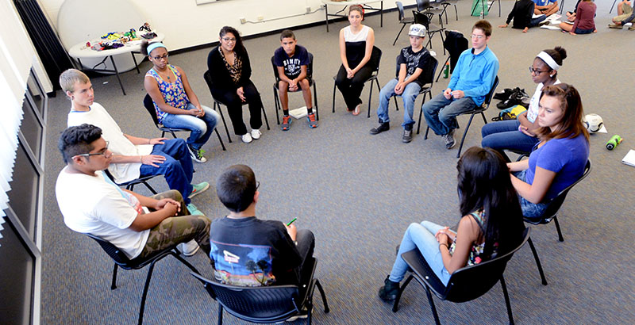
“Circle Up!” to Strengthen Your Community
Restorative circles are for all parties affected by a behavior
  Everyone gets to have their say!
“Circling-Up” versus sending kids away from their community
  This can often reinforce negative behaviors; doesn’t teach conflict management/resolution!
Goals:
  Respect, Relationships, Responsibility, Repair, Reintegration
Assign seats intentionally; consider need to exit quickly; private space
Time-limited time-outs allowed; consequence assigned w/ no return

Slide 21
“Circle Up!” to Strengthen Your Community
Circle Process:
  Call the circle: “ALRIGHT EVERYONE, GRAB YOUR CHAIRS, LET’S CIRCLE UP!”
    At first, teacher calls; once established, students can as well (wrap/grievances)
  Use the talking piece to facilitate discussion (2-10 mins)
    The behavior and mismatch with the expectation
    How everyone was impacted by the behavior
    Brainstorming solutions
    Offer chance to make repairs/amends
    Recap
  Establish as a classroom culture norm early on
Video Example:
https://www.youtube.com/watch?v=38w-WO5qeDY

Slide 22
“Circle Up!” to Strengthen Your Community
Circle Expectations:
  We sit face-to-face to improve our human connection
  We avoid assumptions, subjective (vs. objective) statements
  The circle is a place of physical and psychological safety
  Violations of these expectations = removal from the circle
  “Talking piece;” stick to facts-only language
  We may discuss our views using affirmational “I” statements; not “you!” statements
  We validate hard discussions; praise empathy
  We recap before we wrap

Slide 23

Improving Our Communication
“The power of words is immense. A well-chosen word has often sufficed to stop a flying army, to change defeat into victory, and to save an empire.”
-Emile de Girardin

Slide 24
Restorative Communication
“Let’s talk…”
  Identify the problem behavior
    “I’ve noticed ________...what’s up?”
  Invite the student to speak in private (hallway, after class, etc.)
  Use open-ended questioning
  Guide toward a meaningful resolution
“Why did you do that?!” versus:
  “What happened?”
  “What were you thinking and feeling?”
  “Who did this affect? How so?”
  “What have you been thinking since?”

Slide 25
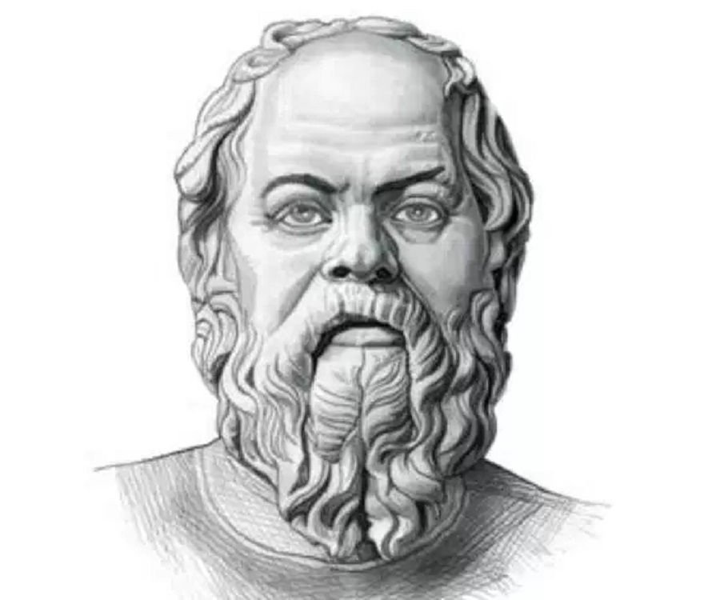
Restorative Communication
The art of “Socratic Questioning”
  “Can you tell me more about that?”
  “How did you/he/she/they respond when…”
  “What led you to think that way?”
  “And then what happened?”
  “What else do you think I need to know right now?”
  “I’m confused/I don’t quite understand…”

Slide 26
Restorative Communication
Encouraging repairs:
  “How do you think ____ felt when you _____?”
  “What do you think you need to do to make things right?”
  “How are you going to carry-out this plan to repair the harm?”
  “Does your plan take care of everyone who was affected by the negative behavior?”
Always, always praise efforts to repair!

Slide 27
The simple things build trust…
Validate and suspend judgment
  “That makes sense…”
  “I can see how that would be hurtful!”
  “You know, I think I’d be frustrated in that situation, too…”
  “I believe you…”

Slide 28
Rebuilding Trust
If a kid is used to unhelpful discipline:
  “I don’t want to tell you what to do…”
  “You’re not in trouble, I just need to talk to you…”
  “I’m not mad at you…”
  “I’m only trying to understand [what you’re going through, what you think/feel about…]”
  “I want to talk about this with you, but I’m OK with waiting until you’re ready…”
  “I know this is different from what we’ve done earlier; I want to try something new…”

Slide 29
Restorative Resources:
Edutopia:
  https://www.edutopia.org/blog/restorative-justice-resources-matt-davis
Restorativeresources.org:
  https://www.restorativeresources.org/educator-toolkit.html
Restorative Solutions:
  http://restorativesolutions.us/resources
Learning for Justice:
  https://www.learningforjustice.org/magazine/summer-2014/toolkit-for-restoring-justice
Restorative Practice Consortium Guidebook:
  https://www.iirp.edu/images/pdf/ObqnNj_38e965_ad7507e9e2474f8aaa3b903afcb1ecf7_2.pdf

Slide 30


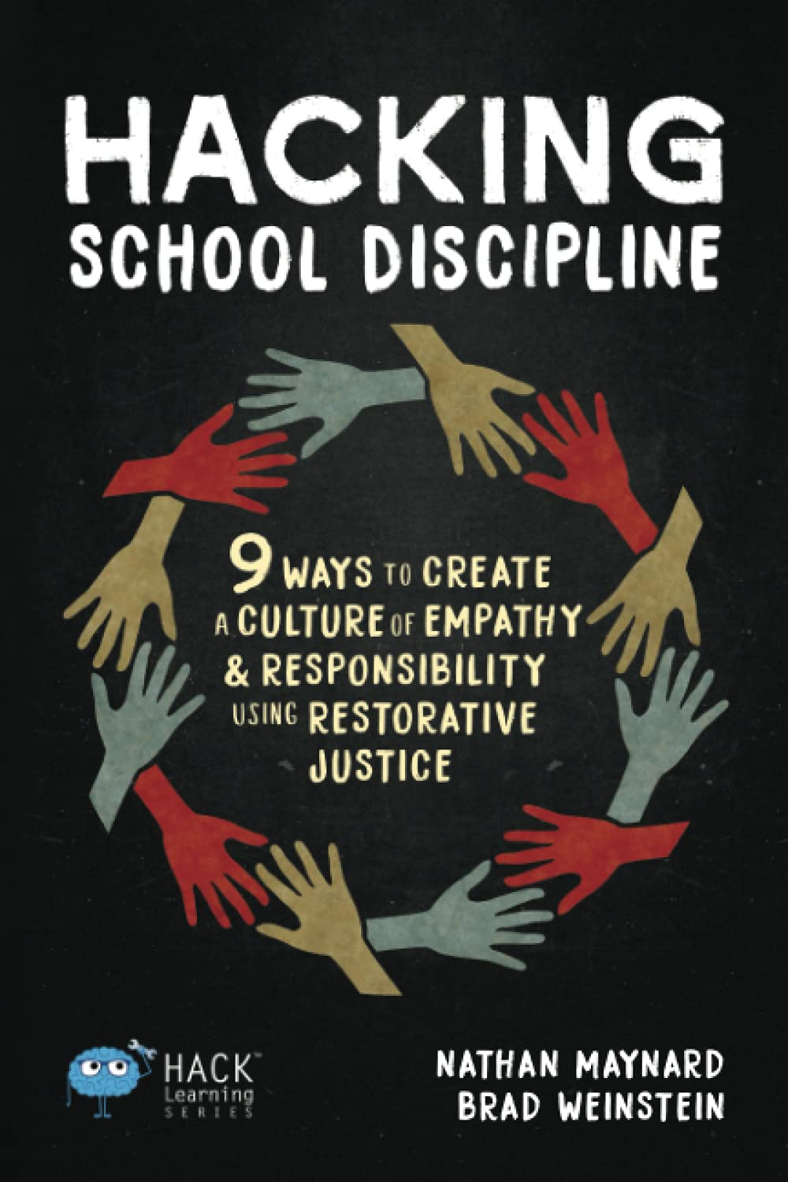
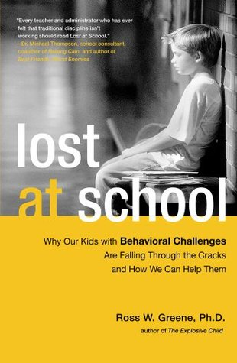

Recommended Readings

Slide 31



Recommended Readings:
Notes:
Greg

Slide 32
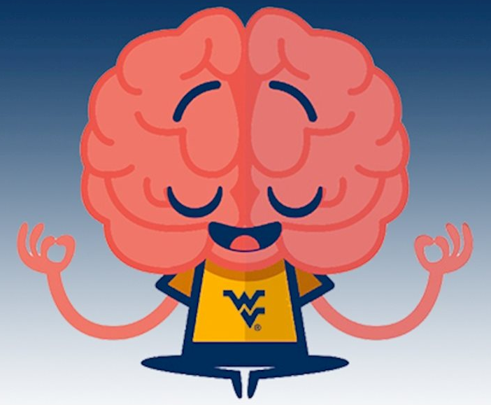
Emotional Regulation Through Mindfulness
Mindfulness:
  An ability we all possess
  Any intentional activity that brings focus to the present moment
    Your environment
    Your breathing/body
    Your thoughts and emotions
  Involves letting go of judgment
  Requires sustained practice
    Exercise your mindfulness muscle daily!
  Learn more at https://www.mindful.org/

Slide 33
ESC 15 is Here to Help!
Contact the ESC 15 mental health team for additional resources:
  Gregory Hickey, LPC: gregory.hickey@esc15.net; (325) 650-8261
  Alex Robles, LPC: alex.robles@esc15.net; (325) 658-6571
  Anne Hardegree, LPC-S: anne.hardegree@esc15.net; (325) 234-5264
  Jessica Flores, LPC, BCBA: jessica.flores@esc15.net; (325) 481-4057
  Carol Stevens: carol.stevens@esc15.net; (325) 651-0101
  mentalhealth@esc15.net to reach all of us!
Notes:
Greg

Slide 34

Any questions?
Concerns?
Lingering doubts or heartburn?

Slide 35
Sources:
Anderson, M. (2018). Getting Consistent With Consequences. Educational Leadership: Classroom Management Reimagined. Vol. 76, 1. Ret from: http://www.ascd.org/publications/educational-leadership/sept18/vol76/num01/Getting-Consistent-with-Consequences.aspx
Collaborative and Proactive Solutions (CPS)/Lives in the Balance
  https://www.livesinthebalance.org/
CDC ACEs study summary
  https://www.cdc.gov/violenceprevention/childabuseandneglect/acestudy/index.html
https://www.learnalberta.ca/content/inspb1/html/7_fairandpredictableconsequences.html
Glasser, W. (1998). Choice theory: A new psychology of personal freedom.
Guarino, K. & Chagnon, E. (2018). Trauma-sensitive schools training package. Washington, DC: National Center on Safe Supportive Learning Environments.
Maynard, N. & Weinstein, B. (2020). Hacking School Discipline: 9 Ways to Create a Culture of Empathy & Responsibility Using Restorative Justice. Hack Learning Series. Times 10 Publications: Highland Heights, OH.
Portell, M. (2019). Understanding Trauma Informed Education. Edutopia. Ret from: https://www.edutopia.org/article/understanding-trauma-informed-education
Durrant, J., & Ensom, R. (2012). Physical punishment of children: lessons from 20 years of research. CMAJ : Canadian Medical Association journal = journal de l'Association medicale canadienne, 184(12), 1373–1377. https://doi.org/10.1503/cmaj.101314. Ret from: https://www.ncbi.nlm.nih.gov/pmc/articles/PMC3447048/

