Slide 1
The AIIMS Portal: Building the Capacity of MEP Staff and Parents
Notes:
Link for AIIMS Portal: https://www.txmigrant.net/Account/CopyRight?returnURL=~%2FAIIMS%2FIndex%2F&genericMessage=False
Idalia will introduce herself and the presentation for today.
I’m Lori Pevoto, and I am a Project Manager for the Federal, State, and Local Initiatives team at Education Service Center, Region 20. Our team works with the TEA MEP team to develop resources and products for the Texas MEP. The portal that we will be sharing with you today is one of those resources.
We wanted to spend a few minutes getting to know the group today. We want to ensure that this session provides the type of support that you need in order to help build your capacity and knowledge of the Migrant Education Program.
To do that we are going to ask everyone to stand and walk to one area in the room, depending on your familiarity with the AIIMS portal.
So, if you are unfamiliar with the portal you will stand over to the left.
If you are somewhat familiar with the AIIMS portal you will go to the back.
If you are familiar with the portal, visit it often and maybe even share it with other MEP staff you will head over to the right.
Now that we are all there, we are going to ask each group to share with each other what they are hoping to gain from today’s session. Once you have all shared, if you could pick someone to share out what was shared. It can just be a summary of the overall conversation.
We are hoping you will be familiar with the portal, and ready to use it to support your work with the MEP when you leave our session today.

Slide 2
Goals for today
Rationale and development of the AIIMS Portal
Accessing the portal
Overview of the AIIMS portal
Next steps for MEP staff
Exploring the content
Implementation ideas
Notes:
Thank you for participating in that with us. We want to be sure to address your expectations and needs as best we can. So knowing what people are thinking will be helpful.
Here are our overall goals for today. As we move through these goals, we will stop to point information that addresses the needs that you all shared with us.
(read goals)

Slide 3
Rationale for the AIIMS Portal
Migratory families, as well as LEA and ESC MEP staff, have communicated common observations:
Services provided and the manner in which the MEP interacts, connects, and supports migratory families may vary greatly from district to district.
Notes:
Idalia
During conversations with migratory families and MEP staff over the past few years, feedback and comments have indicated that the services provided to migratory families, and the manner in which the MEP interacts, connects, and supports them may vary greatly from district to district.
Would you agree with these observations? We know that the services available can be different from one district to another, but the way that those services are provided can be very different as well.

Slide 4
Rationale for the AIIMS Portal
TEA considered:
Why?
What could be done to better align these services and interactions?
The TEA recognized that MEP staff have not had access to standardized, consistent procedures and processes in writing and available in one location.
Notes:
Idalia
When looking at this feedback and considering how to move forward, TEA considered:
Why is this information different and varied from district to district?
What can be done to better align the services and interactions MEP staff are providing to all migratory families across the state?
The TEA recognized that information and services may vary from district to district because MEP staff have not had access to standardized, consistent procedures and processes in writing and available in one, easy to access location.

Slide 5
Rationale for the AIIMS Portal
Develop an online resource portal to
Provide clear, concise procedures and processes to support MEP staff and migratory families
Help ensure all students enrolled in the Texas MEP have consistent inter- and intrastate support to ensure educational continuity and to successfully transition to postsecondary education, military, and/or career.
Provide support for non-MEP staff who also support migratory students (counselors, administrators, etc.)
Notes:
Idalia
So, the decision was made to develop an online resource portal to address this issue. That resource is the AIIMS portal.
(review bullets)

Slide 6
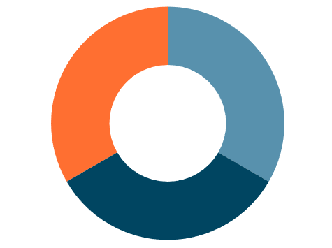
Content Development
Pilot LEAs
ESC MEP Staff
TEA MEP Team
Notes:
Lori
The content for this portal was developed through a collaborative effort.
M-E-P staff members from various ESCs and the TEA M-E-P team worked together to draft the content for the AIIMS Portal.
Then, the seven largest sending and receiving districts across the state served as Pilot LEAs, implementing some of the processes and procedures and providing feedback on them as well as the draft content.
For the draft content for the Parents and Families section, the Pilot LEAs coordinated with their MEP PAC members. These parents helped to ensure the information provided in that section of the portal is meaningful and useful for migratory families.
All of these pieces came together to create the AIIMS Portal.

Slide 7
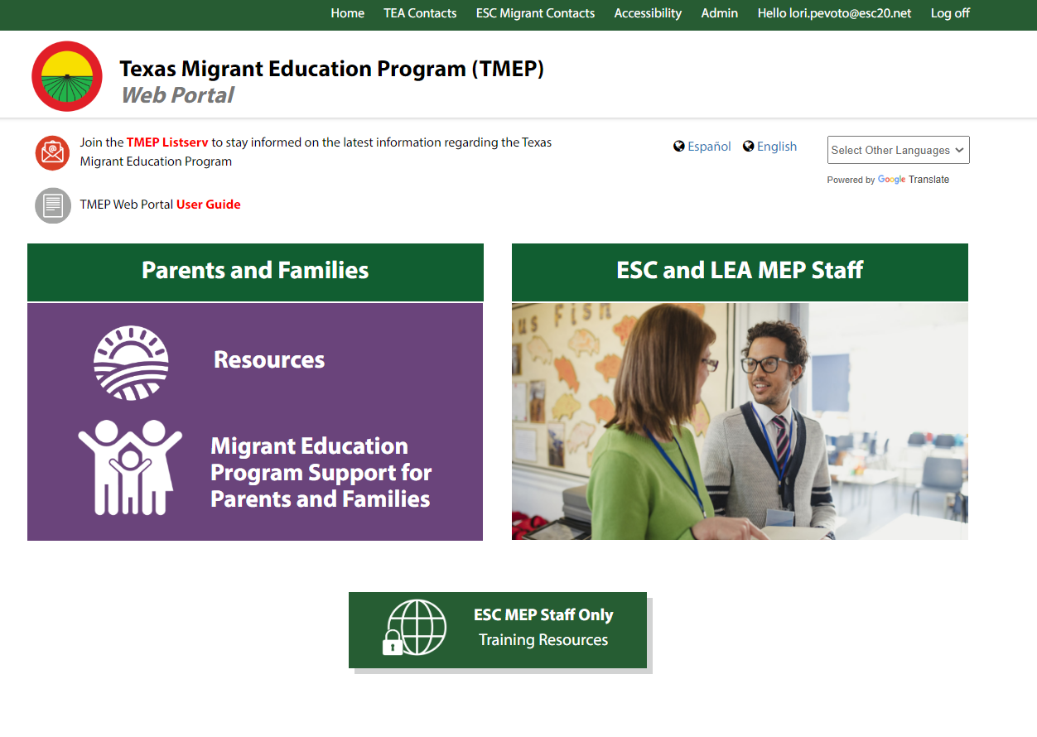
Accessing the AIIMS Content
Notes:
Lori
Now that we have discussed the rationale behind this portal, as well as how the content was developed,let’s talk about HOW to access the AIIMS portal. First, visit the TMEP portal at txmigrant.net.
The AIIMS portal is one of many resources provided by the TEA and linked on the TMEP portal.

Slide 8
Accessing the AIIMS Content
Notes:
Lori
As MEP staff, you will find the AIIMS portal in the MEP staff section.

Slide 9
Accessing the AIIMS Content
Notes:
Lori
The AIIMS icon is located in the center of the top row.
For those of you following along on your device, does anyone need me to show how to get to the AIIMS icon again?

Slide 10
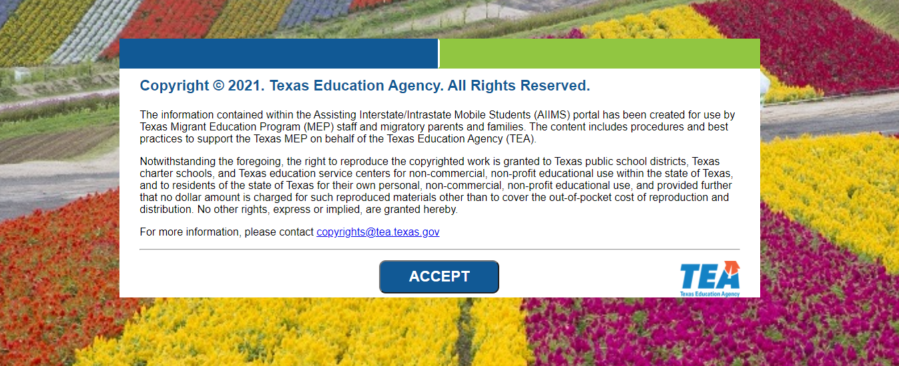
Accessing the AIIMS Content
Notes:
Lori
Each time a user visits the AIIMS portal, they will see this statement.
The statement shares copyright and acceptable use of materials information with the user.
When you visit the portal, please take a moment to read that information. Once you have read the statement, selecting “accept” directs you to the home page of the AIIMS portal.
(PAUSE)

Slide 11
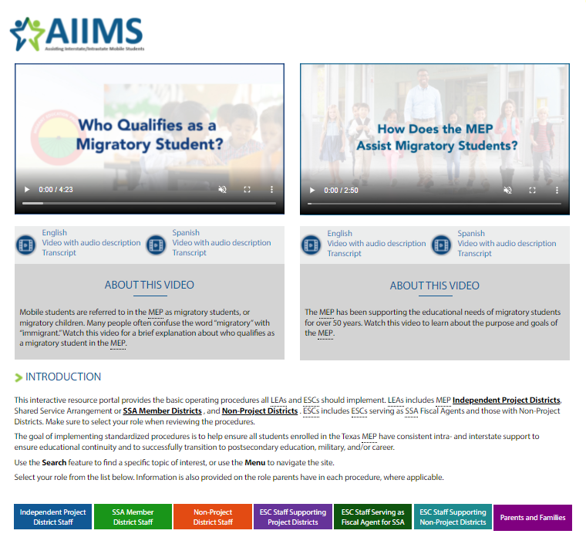
Overview of AIIMS Portal
Notes:
Lori
Go to the live site
The top of the home page has two videos: Who Qualifies as a Migratory Student and How Does the MEP Assist Migratory Students. There are several different ways these videos could be used. They could be helpful to staff who are new to the MEP and still learning about the program. LEA MEP staff could also share these videos with administrators and district staff (teachers, counselors, etc.), who are not MEP staff, to help build their understanding of the work you do and the MEP in general.
Underneath the videos you see the Introduction to the portal.
Information about the different types of programs available here in Texas are linked in the introduction. This information may again be useful for new MEP staff as they learn more about how they fit in the program overall. Content within the portal is organized by the different MEP programs that are available, so this introduction is helpful if you are not sure where to begin.
Users will choose their role from the menu to access content relevant to them and the type of program they work with. As you can see, the options include Independent Project District Staff, SSA Member District Staff, Non-Project District Staff, ESC Staff Supporting Project Districts, ESC Staff serving as a Fiscal Agent for SSAs, ESC Staff Supporting Non-Projects, and Parents and Families.
There are a few interactive features included throughout the portal. One of these helps users with the many different acronyms that are used in education and the MEP. If you hover over any acronym, the spelled-out meaning will appear. Also, there are many clickable links within the text that may redirect you to other resources about that topic. The font color for these links is blue, and when you hover over them you should see them underlined.
Notice that there is also a search feature at the top of the page. This feature can be found on all portal pages. When you have a specific topic you are looking for, you can use the search feature to find all of the pages and even linked PDFs that reference that topic.
Users will want to use the menu, which will appear on all of the portal pages, as well as the back arrow of your browser, to move around the portal.

Slide 12
Overview of AIIMS Portal
Notes:
Lori
We would like to walk you through each section of the portal to provide a brief overview of the content and how to navigate it. Remember, the portal is organized by the different roles and programs of the MEP. We will start with the Independent Project District Staff tab. This section contains information useful for LEA MEP staff whose district participates in the MEP as an Independent Project District. If this describes your role, you will want to visit here to find information focused on your program. This content has been available since 2021.
If we click on the Independent Project District role, you will find six sub-sections of content for MEP staff members: Responsibilities of Ind project districts, Interstate and intrastate Coordination, College, Career and Military Readiness, Parent and Family Engagement, Migrant Service Coordination, and OSY.
The first subsection listed, Responsibilities of Ind. Project Districts, shares a great overview for Independent Project Districts, including basic requirements and responsibilities for the program. We recommend ALL Project district staff bookmark this page and take time to review it.
We can see examples of the clickable links within the text mentioned a moment ago, for example (CIC, ESSA Consolidated, etc).
We can also see some of the acronyms mentioned, when I hover over them we can see what they mean.
Notice that once we leave the home page for the portal, the main menu moves to the top of the page.
Many of the subsections in this part of the portal contain overarching questions at the bottom of the page to help organize the content for that topic. When we look at the CCMR section, we can see there are four of these questions at the bottom of the page. (read)
Next, we can look at the parent engagement section, along with the questions at the bottom. We can click on the Steps for Hosting a Parent and Family Engagement session. Throughout the site, you will see downloadable Sample documents, such as the Sample agendas you see here. In many cases there will be fillable versions of forms MEP staff may want to use as well, to help make operating the program a little easier.

Slide 13
Overview of AIIMS Portal
Notes:
Lori
Moving to the next section on the menu, the SSA Member District Staff section was added to the portal September 2022. This section contains information useful for LEA MEP staff whose district partners with their regional ESC in a Shared Service Arrangement, or SSA. The responsibilities and requirements of LEA MEP staff whose district is part of an SSA are different from the Independent Project District. So this section discusses those differences.
If we click this section tab, you will notice that you go directly to the page. There are not subsections for the SSA Member District section, or any of the others on the portal. The main page for this section still provides a great overview of the program. Then at the bottom of the page, there are additional pages linked that share information about coordinating efforts between SSA Member Districts and their fiscal agents, or ESC, a timeline of activities, and resources for MEP staff.

Slide 14
Overview of AIIMS Portal
Notes:
Lori
The Non-Project District Staff tab is next on the menu. This section is the last section intended for LEA MEP staff. Currently, this section is in the design process and will be available on the portal in November.
We can see it is currently not available when we hover over it because we see the red circle and a “Coming soon” message. We will share through our MEP Listserv when this section is available, so if you have not signed up for that yet you will want to. Please let us know if you need assistance finding that and signing up for it. We can show you before you leave today.

Slide 15
Overview of AIIMS Portal
Notes:
Lori
As we continue down the menu, the next tab is the first section with information for ESC MEP staff. This section provides support for ESC MEP staff whose service center supports Independent Project Districts. This content has been available since 2021.
When we click on this purple tab, we are directed straight to the site.
Just like the other pages we have viewed, an overview of the responsibilities and program requirements for ESCs who support Independent Project Districts are shared on this main page. This page shares this information with the use of expandable lists. So if we click these arrows we will find more information. There are four additional pages at the bottom of this page. (read them)

Slide 16
Overview of AIIMS Portal
Notes:
Lori
Next on the menu, we come to the second section for ESC MEP staff. This is one of the newly launched sections. The content provides information for ESCs who serve as fiscal agents in an SSA.
Like the other pages we have looked at, this main page shares the responsibilities for staff in this role, that means ESCs who are serving as fiscal agents. Both the ESSA Basic Services grant and the ESSA Consolidated Grant are discussed in this content. A video has been included to help further illustrate the partnership between the SSA Member District and the Fiscal Agent in a Shared Service Arrangement.
There are several additional pages for this section included at the bottom of this page. (read them)
Let’s click on “Coordinating Efforts Between SSA Member Districts and Their Fiscal Agents”. Here we can see more information about different aspects of the MEP SSA that require coordination between the Member District and their ESC. (review them)

Slide 17
Overview of AIIMS Portal
Notes:
Lori
The last tab on the menu with content intended for MEP staff is ESC Staff Supporting Non-Project Districts. Like the Non-project District section for LEAs, this section for ESCs is in the design process and will be made available in November.
Again, we see the red circle and “Coming soon” message when we hover over this section.

Slide 18
Overview of AIIMS Portal
Notes:
Lori
Finally, the Parents and Families tab. The content in this section was written with migratory parents and families as the intended audience. This is the content that the MEP PAC members from the Pilot LEAs in Texas provided feedback on during development. This section is available in both English and Spanish. As staff, you will click the last tab to access this content, just like the other sections intended for staff. If parents are accessing this section, we have a streamlined process, and I will show you that in just a moment. Let’s first look at what can be found here.
There are some differences between this section and the others we have viewed so far. You can see there is a frequently used terms section at the top. This section shares a lot of resources for students and children of all ages. Users will see the MEP icon next to any resources that are only available for migratory students. So resources like CAMP, ABB, or Project SMART have that icon next to them.
As we scroll down, you can see that there are several videos available for parents. Videos were used to help provide more clarity to the content being shared. These videos are fully accessible and available in both English and Spanish.
At the very bottom there are several sections that address the needs of children at all ages. Information for school age students, migratory children who are out-of-school youth, or OSY, information to help prepare high school students for graduation, support to help parents learn to be advocates for their children, and technology support. This last section compiles all of the websites, videos, and documents that are referenced throughout these pages in one place.
Are there any questions about any of the sections we have walked through on the portal?
I mentioned that we have a more streamlined process for parents to access this section. I would like to show you that now.

Slide 19
Parent Access to AIIMS
Notes:
Lori
If we go back to the TMEP portal home page, you will see a section for Parents and Families. We have linked the AIIMS Parents and Families section right from this home page. Parents can click “Migrant Education Program Support for Parents and Families” to access that section directly. This is how MEP staff should show parents how to access this section on their own.
Are there any questions about how families can easily find the AIIMS portal content developed for them?

Slide 20
Next Steps for MEP Staff
Read through the content within the section that best meets your needs.
Notes:
Lori
Now that you know about the portal and what is available for MEP staff and parents and families there, we would like to talk about next steps after you leave here today for you and the MEP staff you work with.
First, you can read through the content within the section or sections that best match your role and meet your needs. Visiting the site often helps you become familiar with the organization of the content and allows for more efficient use of the resources available there.

Slide 21
Next Steps for MEP Staff
Read through the content within the section that best meets your needs.
Implement the procedures and processes as outlined, adjusting specific steps to align with the needs of your migratory students and families and the resources available in your district/region.
Notes:
Lori
Then, implement the procedures and processes as outlined. You can adjust specific steps to align with the needs of your migratory students and families as well as the resources available in your district and region.

Slide 22
Next Steps for MEP Staff
Read through the content within the section that best meets your needs.
Implement the procedures and processes as outlined, adjusting specific steps to align with the needs of your migratory students and families and the resources available in your district/region.
Ensure all MEP Staff within your district are aware of the portal and are actively using it as they implement the MEP.
Notes:
Lori
Finally, LEA MEP staff can ensure all MEP staff within your district are aware of the portal and are actively using it as they implement the MEP. ESC MEP staff can find ways to implement the portal into their communication and different training sessions with the districts in their region.
MEP staff will want to share the Parents and Families section with the families they support. This could be done many ways. Some examples include newsletters, PAC meetings, or family nights.
Does anyone have any questions about next steps?

Slide 23
What is Your Role?
What is your role in the MEP?
ESC staff
LEA/district staff
Other
What type of MEP?
Independent Project District
SSA Member District
Non-Project District
Fiscal agent for an SSA
Other
Notes:
Lori
We would like to give you some time to explore the portal on your own, but before we do that we would like everyone to consider their role in the MEP. Knowing this information will help you select the section of content that will best meet your needs.
So, on the slide we have some questions for you to consider. (read the questions)
You can visit any section, but to help figure out a place to start, you can begin in the section that matches your current role in the MEP.
We are here to help if you have any questions about your role.

Slide 24
Exploring the Content
Explore the site
Questions? Please ask.
www.txmigrant.net
Notes:
Lori
Ok, if you have a device please feel free to take this time to explore. If you do not have a device we can bring up any pages you would like. Please just let us know and we can use our computer and the screen to share portal pages you are interested in.
(Recommendations of what they can do, and where they can go, if there are some who are a little apprehensive.)
(pause until about 5 minutes left in the session)

Slide 25
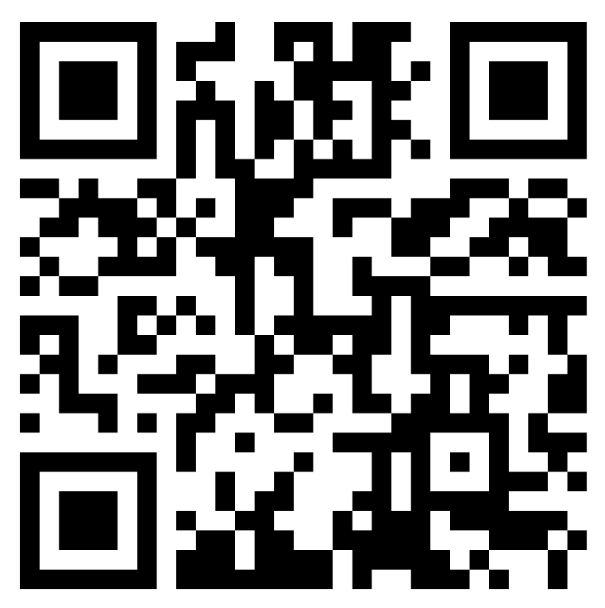
Implementation
Please join the Padlet to view and share your implementation ideas.
Notes:
Lori
The last thing on our agenda today is to spend some time sharing ideas to implement the AIIMS portal in your program.
(If there isn’t a lot of conversation ask: How could you build awareness of the portal with the MEP staff you work with.)
Padlet:https://region20.padlet.org/MEPGrants/q9h2umspckuf54kc

Slide 26
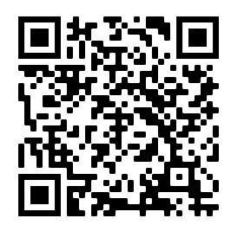
Upcoming Events
Visit the registration page on the TMEP portal.
Notes:
Lori
We have a couple of events that registration is open for right now. We want to share that information with you in case you have not had the chance to check them out and register.
We have a registration page on the TMEP portal, and registration is available for the Spring showcase and we are accepting applications to present until Nov. 28th as well.

Slide 27
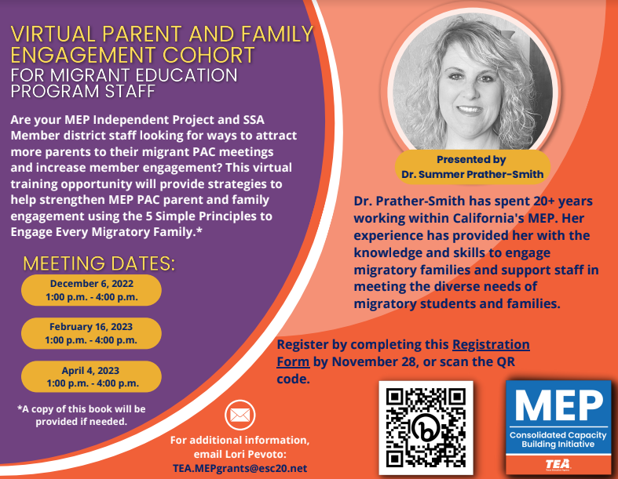
Upcoming Events
Register TODAY!
Notes:
Lori
We have a couple of events that registration is open for right now. We want to share that information with you in case you have not had the chance to check them out and register.
Our first Best Practices Virtual Showcase will be help next week. We have some wonderful presenters from La Joya ISD and PSJA ISD, but from Region 1. We are excited for participants to join us and hear some of the ways the best practices these two LEAs have found to help them implement the MEP in their district.
We have a registration page on the TMEP portal, and registration is available for both the Fall and Spring showcase.

Slide 28
Final Thoughts
If you have any questions or need any support, please contact:
Lori Pevoto
Project Manager
Federal, State, and Local Initiatives
Education Service Center, Region 20
TEA.MEPgrants@esc20.net
Notes:
Thank you for your ideas and for sharing with us today. If you have any questions or need support please contact (review contact information)

