Slide 1


NGS & MSIX ACADEMY
2018|2019
Presenters:
Melba D. Garza, NGS/MSIX State Trainer
Esmeralda Solano, ESC Region 20
Jose Guereca, South San Antonio ISD
AMET Conference | South Padre Island Convention Center | November 7-9, 2018
Notes:
Nothing.

Slide 2

ACTIVITY #1
Non-Verbal
Communication
INSTRUCTIONS
Without talking, line up around the room by your birthdate.
Notes:
After the participants have lined up by birthdate check for accuracy and have a group discussion about how it felt. Talk to them about change and how we have to adapt to changes each year. Explain the reason changes are good and necessary to the success of the migrant education program. Count all participants depending on room set up. Sit the groups together and hear the first change.
Time: Allow about 2-5 minutes

Slide 3
If nothing ever changed,
there would be no butterflies.
−Unknown
Notes:
Display while participants are lining up.

Slide 4

ACTIVITY #2
Fear in a Hat!
INSTRUCTIONS
Write down your fears on a sheet of paper related to NGS and MSIX.
Notes:
Fear in a Hat is a teambuilding exercise about change.
Required Items: writing utensils, sheets of paper, and a hat(s).
Instructions: Scatter hats around the room. Ask individuals to write their fears relating to NGS/MSIX (anonymously) on sheets of paper which are then crumbled and toss it into a hat.
Time: Allow about 1-2 minutes of writing time, plus 5 minutes to read a couple of fears with the audience.
Take turns reading one fear aloud, and ask participants to explain what the fear means.
Discuss as a whole group what are some of the common fears.
Fears will be read throughout the day and answer given to any questions.

Slide 5
“The Secret Of Change Is To Focus All Of Your Energy, Not On Fighting The Old, But On Building The New.”
−Socrates
Notes:
Display while reading the fears.

Slide 6

Purpose
This year’s academy will introduce the New 2018-2019 Texas Data Management Requirements Manual for NGS and MSIX. The session aims to establish an instructional setting where various scenarios and activities will allow participants to learn the context and materials needed to successfully implement the required NGS/MSIX activities.
Notes:
Small introductions
Read Purpose
Let them know this Academy is an interactive forum.

Slide 7

New Look and Feel
New Guidance!
New Look!
Notes:
We’ve redesigned the look and feel, including our logo, color scheme, and typography.
The NGS Review Team worked to find something that appeared modern and approachable.
The primary focus was to expand on the guidance already provided with additional clarification and new content such as MSIX.

Slide 8
NGS Review Team
Melba D. Garza—NGS/MSIX Help Desk
Raul Cantu—NGS/MSIX Help Desk
Ester Carrillo—ESC 10
Maria Elena Cortez—ESC 1
Dr. Paula Freeman—ESC 13
Jose Angel Guereca—South San Antonio ISD
Olga L. Gutierrez—ESC 13
Glenda Hadley—ESC 16
Miriam Kelley—ESC 10
Jacob Ortega—ESC 20
Elizabeth Rangel—ESC 15
Manuel P. Salinas—ESC 1
Julissa F. Sandoval—ESC 1
Esmeralda Solano—ESC20
Notes:
We’ve redesigned the look and feel, including our logo, color scheme, and typography.
The NGS Review Team worked to find something that appeared modern and approachable.
The primary focus was to expand on the guidance already provided with additional clarification and new content such as MSIX.

Slide 9
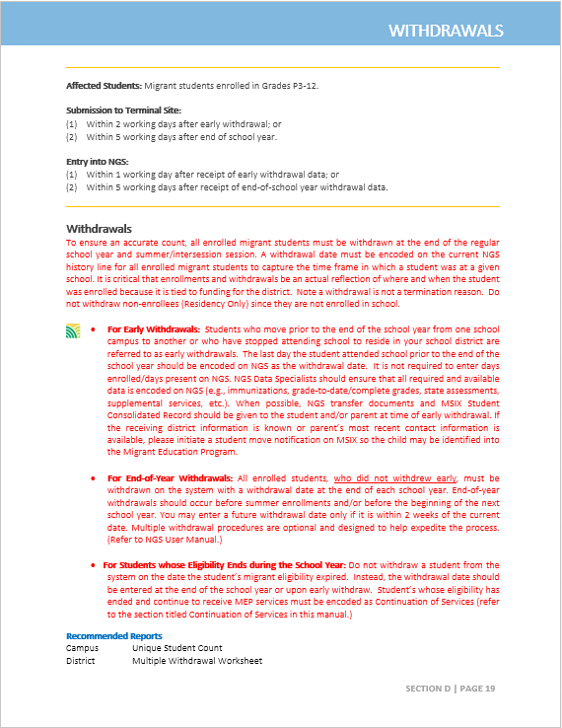
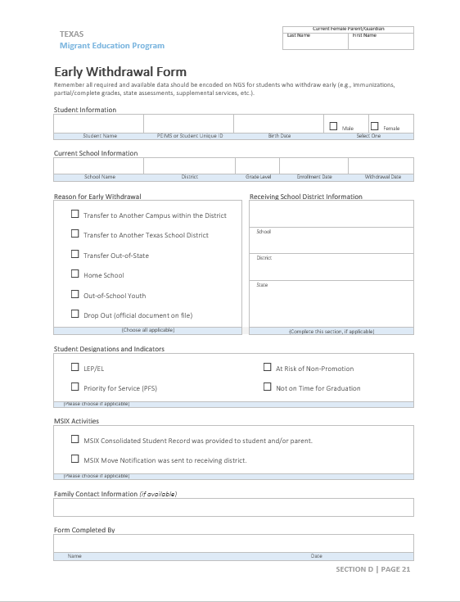
Notes:
If time allows
Focus on Tabs
Show different areas
Remove Red text

Slide 10

Break Time | 2:00 – 2:30 p.m.
Notes:
Remind participants that they need to come back to win door prizes and that are going to have some great activities for them. Assure them that we are available for questions at anytime.

Slide 11

REVIEW SECTIONS
Enrollments
Withdrawals
Student Consolidated Record
Move Notifications
Data Requests
Notes:
Enrollments – When training the users about enrollments on NGS the ESC needs to cover all aspects of enrollments such as:
Individual Enrollment
Multiple Enrollment
Family Enrollment
Withdrawals – Talk about the multiple withdrawal feature on NGS and the importance of early withdrawals, engage the participants by asking them “Why is it important to take care of early withdrawals right away?” and what needs to be done for those students who are withdrawing and leaving early?
(give a door prize to the person who answers these two questions correctly)
MSIX Consolidated Student Record – Review with your LEA’s how to produce this record on MSIX and also go over the MDE’s that DESs should be able to spot check to ensure that the data is accurate. Ask your LEAs to become familiar with the record for future reference. LEA’s also need to be sharing this record with parents, students and any personnel who serves MEP students.
MSIX move notifications – The ESC should be encouraging the LEA’s to use this feature on MSIX whenever one of their migrant students is withdrawing early or when the DES or recruiter finds out that a migrant family is leaving the area. Families usually return to the last place of employment within Texas or in another state.
Data Requests can be submitted when needed to find out more information for a student. (e.g.. Grades, Health information..) If necessary a copy of the last COE can be requested as long as you make sure not to send any personal identifiable information (PII).

Slide 12
Enrollments for Fall and Spring Semester
Non-Enrollees
These are residency only children encoded with an enrollment type “P”
Request the 2 year turning 3 Report
A new history line must be entered for each reporting period
Enrollees
These are students encoded with an enrollment type “R”
Request the Student Unique Count
Add a new enrollment line whenever there is a new residency date and/or enrollment date, even if there is not a new QAD
Notes:
The Student Unique Count allows a user to verify that the enrollment was captured and to also ensure the enrollment type is correct. Users should do this at least when there are new enrollments.
Enrollments – When training the users about enrollments on NGS the ESC needs to cover all aspects of enrollments such as:
Individual Enrollment
Multiple Enrollment
Family Enrollment

Slide 13
Scenario #1
Juana Ines de la Cruz is a 9th grader who was retained last year. After the first semester, she was promoted to 10th grade. What should the NGS Specialist do on NGS?
Notes:
Answer is on the next slide!

Slide 14
Scenario #1
Juana Ines de la Cruz is a 9th grader who was retained last year. After the first semester, she was promoted to 10th grade. What should the NGS Specialist do on NGS?
Answer: For a student whose grade level has changed during the reporting period, the NGS Data Specialist should never change the grade level on the current enrollment line (unless the grade level was entered in error). Instead, the user should close out the current enrollment line with a withdrawal date and create a new enrollment line reflecting the grade change. Comments on the history line should state that the student was promoted to the next grade level.
Notes:
Give a door prize to the person who can answer this questions correctly.

Slide 15
Scenario #2
Octavio Paz resides in San Antonio ISD and attends KIPP Aspire Academy, a charter school located in San Antonio, Texas. The Recruiter from San Antonio ISD picks up the COE for the Paz family as residency only. The COE is submitted to the NGS terminal site in San Antonio ISD. What steps should the NGS specialist take to process the shared COE on NGS?
Notes:
Answer is on the next slide.
Takeaways:
Participants will learn how to obtain charter schools served by their regions using AskTED
Participants will understand the sharing process for COEs,
Participants will understand what the definition of a charter school is.
Participants will understand the required NGS activities for project and non-project charter schools.
Resourcces:
AskTED
TEAL/TEASE
ITTCS/PEIMS
NGS/MSIX Helpdesk

Slide 16
Scenario #2
Octavio Paz resides in San Antonio ISD and attends KIPP Aspire Academy, a charter school located in San Antonio, Texas. The Recruiter from San Antonio ISD picks up the COE for the Paz family as residency only. The COE is submitted to the NGS terminal site in San Antonio ISD. What steps should the NGS specialist take to process the shared COE on NGS?
Answer: The student should be encoded as “residency only” in the residing district on the auditable copy of the COE. The school of attendance should use the copy of the COE to encode eligibility information on NGS and print out the NGS enrollment screens to document student enrollment. These NGS screen shots should be attached to the copy of the COE and maintained on file by the school of attendance. If school records are provided for enrollment data, file them along with the COE. ESCs that serve as the fiscal agent should share copies of the COE and SDF with non-project districts, charter, and magnet schools.
Note: A charter school is not tied to any geographical location, refer to AskTED to determine if the school pertains to your region.
Notes:
Questions for Table Groups
Why did the recruiter submit the COE as residency only?
Who is responsible for ID&R?
Who should claim an enrollment line?
Who is responsible to serve the student?
Takeaways:
Participants will learn how to obtain charter schools served by their regions using AskTED
Participants will understand the sharing process for COES,
Participants will understand what the definition of a charter school is.
Participants will understand the required NGS activities for project and non-project charter schools.
Resourcces:
AskTED
TEAL/TEASE
ITTCS/PEIMS
NGS/MSIX Helpdesk

Slide 17
Withdrawals for the Fall Semester
Non-Enrollees
Do not withdraw non-enrollees (Residency Only) since they are not enrolled in school.
Enrollees
For Early Withdrawals: Enter the last day the student attended school prior to the end of the school year.
Notes:
Withdrawals – Talk about the multiple withdrawal feature on NGS and the importance of early withdrawals, engage the participants by asking them “Why is it important to take care of early withdrawals right away?” and what needs to be done for those students who are withdrawing and leaving early?
(give a door prize to the person who answers these two questions correctly)

Slide 18
Scenario #3
Gabriel Garcia Marquez is a new NGS Specialist. He has a COE with two children whose eligibility ended November 3, 2018. Mr. Marquez has entered a withdrawal date on NGS for each student as of November 3rd. Is this the correct process?
Notes:
Guiding questions:
What is the process the NGS specialist should follow?
Prize Question

Slide 19
Scenario #3
Gabriel Garcia Marquez is a new NGS Specialist. He has a COE with two children whose eligibility ended November 3, 2018. Mr. Marquez has entered a withdrawal date on NGS for each student as of November 3rd. Is this the correct process?
Answer: For Students whose Eligibility Ends during the School Year, do not withdraw a student from the system on the date the student’s migrant eligibility expired. Instead, the withdrawal date should be entered at the end of the school year or upon early withdraw.
Notes:
Guiding questions:
What is the process the NGS specialist should follow?
Prize Question

Slide 20
MSIX Student Consolidated Record
Code of Federal Regulations 200.85 (c)
LEAs are required to use the Student Consolidated Record for the purposes of enrollment, grade and course placement, and accrual of secondary course credits for all Texas migratory children
MSIX Data Correction
Each ESC/LEA must establish and implement written procedures to correct MSIX data.
Records Transfer
Provide the Consolidate Student Record Report upon Early Withdrawal to parents.
Notes:
MSIX Consolidated Student Record – Review with your LEA’s how to produce this record on MSIX and also go over the MDE’s that DESs should be able to spot check to ensure that the data is accurate. Ask your LEAs to become familiar with the record for future reference. LEA’s also need to be sharing this record with parents, students and any personnel who serves MEP students.

Slide 21
Move Notifications & Data Requests
Move Notification
MSIX provides an e-mail notification feature to alert another area of a student's relocation in the case of their arrival or departure.
Data Requests
Submit request for the purposes of timely school enrollment, appropriate grade and course placement, accrual of secondary credits, and participation in the Migrant Education Program
Notes:
Move Notifications are an integral part of the student records transfer and the ID&R process in the Migrant Education Program. MSIX provides an e-mail notification feature to alert another area of a student's relocation in the case of their arrival or departure.
Migratory children frequently enroll in new schools without adequate, and in many cases any, documentation of their educational and health history. MSIX allows users to request missing data and information from other school districts within Texas and outside of the state for the purposes of timely school enrollment, appropriate grade and course placement, accrual of secondary credits, and participation in the Migrant Education Program. Texas users should seek to develop and support collaboration within the state and among other States on the exchange of migrant student data.
Enrollments – When training the users about enrollments on NGS the ESC needs to cover all aspects of enrollments such as:
Individual Enrollment
Multiple Enrollment
Family Enrollment
MSIX move notifications – The ESC should be encouraging the LEA’s to use this feature on MSIX whenever one of their migrant students is withdrawing early or when the DES or recruiter finds out that a migrant family is leaving the area. Families usually return to the last place of employment within Texas or in another state.
Data Requests can be submitted when needed to find out more information for a student. (e.g.. Grades, Health information..) If necessary a copy of the last COE can be requested as long as you make sure not to send any personal identifiable information (PII).

Slide 22

ACTIVITY #3
Balloon Juggle
INSTRUCTIONS
Participants, your group will get a balloon it is your responsibility to keep it in the air.
Notes:
Stand up and form a circle with your table groups
A balloon will be introduced to the group, it is your job to make sure it does not touch the ground ( everyone must touch the balloon)
Be ready for any surprises!

Slide 23

REVIEW SECTIONS
Priority for Services
Continuation of Services
Graduation Plans
Alternate Student ID
Notes:
PFS Report – Review and allow for Q & A. Remind them that the report should be requested once a month at their desired date, the first of the month, middle or end. PFS Tracking report can be used to check if the reports are being run.
Continuation of Services – Districts should be encouraged to print this report before the end-of-school year and deliver the report to their MEP Coordinator for review. Remember that on NGS there is now a check box with a drop-down selection that should be added for each student when a district has COS students.
Graduation Plans – there is new information available (Review)
Alternate Student ID (Reminder)– The districts should continue to collect and encode both the Alternate ID and the Student UID if available for all students who are enrolled in school. This is very important because they are tied to the State Assessment download that occurs on NGS. NGS DES should request the Alternate Student ID Number report by February 1st so that the terminal site has enough time to encode the data by the last working day in February.

Slide 24
Priority for Service and Continuation of Services
Requesting PFS Reports
Even when no PFS students appear on the report, a PFS Report must still be requested.
PFS vs COS
A child who is being served by the MEP under COS can not be considered PFS because such child does not meet the “migratory child” definition. However, the child will still appear on the PFS report until the end of the year.
Notes:
PFS vs COS: Eligibility ended for example in November of the current year.
PFS Report – Review and allow for Q & A. Remind them that the report should be requested once a month at their desired date, the first of the month, middle or end. PFS Tracking report can be used to check if the reports are being run.

Slide 25
Scenario #4
On August 20, 2018, Federico García Lorca and Sandra Cisneros enrolled for the first time in a Texas school. Federico is a twelve year-old student in 5th grade and Sandra Cisneros, his cousin, is a eight year-old in 1st grade.
Both students appear on the same COE with a new qualifying move from Mexico to the United States with no previous NGS history. The NGS specialist ran the PFS report and noticed that Sandra was listed but not Federico. Can you help explain why?
Notes:
What is the criteria for PFS
Why doesn’t a student drop off the PFS report once he has received services and met state assessments?
Student will remain on the report for reporting purposes to OME for the entire fiscal year.

Slide 26
Scenario #4
On August 20, 2018, Federico García Lorca and Sandra Cisneros enrolled for the first time in a Texas school. Federico is a twelve year-old student in 5th grade and Sandra Cisneros, his cousin, is a eight year-old in 1st grade.
Both students appear on the same COE with a new qualifying move from Mexico to the United States with no previous NGS history. The NGS specialist ran the PFS report and noticed that Sandra was listed but not Federico. Can you help explain why?
Answer: The criteria for state assessment was not met by Federico; however, Sandra does meet the criteria for overage based on her age and grade level.
Notes:
What is the criteria for PFS
Why doesn’t a student drop off the PFS report once he has received services and met state assessments?
Student will remain on the report for reporting purposes to OME for the entire fiscal year.

Slide 27
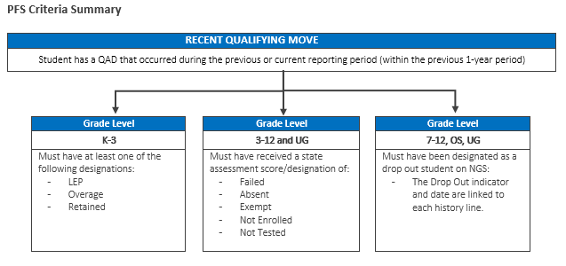
PFS Criteria
Notes:
Not enrolled – students withdrawal prior to testing, ex. Residency only
Not Tested- 8th grade student taking Alg1, so student will only take the Alg. 1 EOC and not the 8th STAAR Math. Ex 2, student tests in Harlandale ISD and moved to a different district, student will not test at new district as they have already tested in Harlandale ISD.

Slide 28

ACTIVITY #4
I SPY
INSTRUCTIONS
What’s new?
Notes:
What’s new in this section?
Continuation of service has drop down box.
Out-of-school transcript should be checked off if you receive an out of state transcript from either a parent or school administrator.
Not new but need to review.
Here to work – is anyone bothering to check this off? Or do you know when to check it off?
Home Schooled - any one using and does anyone know when to use it.
There is a new Colum to the course history screen.
Has Algebra – if the student has taken a full credit of algebra check this box at least once

Slide 29
Graduation Plans
Maintaining Updates
Remember to ask high school counselors to notify the terminal site whenever there is a change in a student’s graduation information.
Obtaining Graduation Plans
Graduation plans must be submitted and obtained from the child’s homebased district.
Notes:
Graduation Plans – there is new information available (Review)
Alternate Student ID (Reminder)– The districts should continue to collect and encode both the Alternate ID and the Student UID if available for all students who are enrolled in school. This is very important because they are tied to the State Assessment download that occurs on NGS. NGS DES should request the Alternate Student ID Number report by February 1st so that the terminal site has enough time to encode the data by the last working day in February.

Slide 30

ACTIVITY #5
Surviving Grad Plans
INSTRUCTIONS
Review your Graduation Plan Form and complete the NGS Screen Handout!
.
Notes:
We will pass out the hand out for Graduation plan and walk through it with the participants.

Slide 31
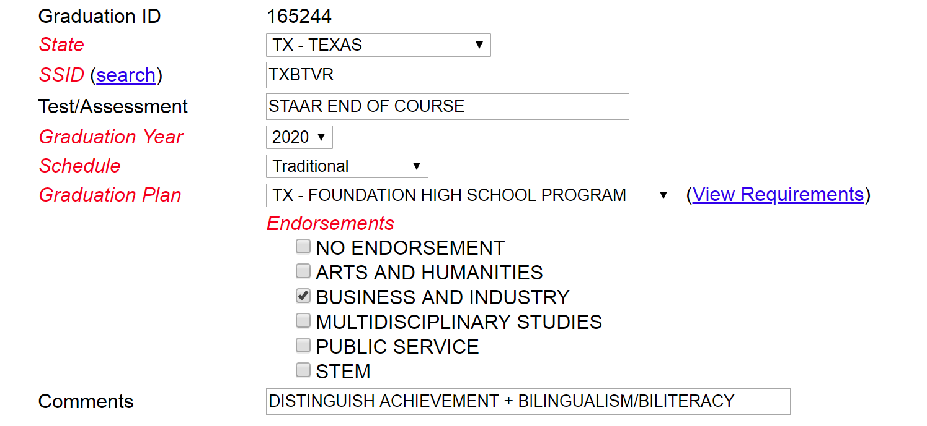
Activity #5 |Graduation Plan Answer Key
Notes:
Graduation Plan Reminders:
It is the responsibility of the MEP Coordinator, along with the campus counselors and the NGS Data Specialist, to gather the graduation plans for input into NGS and to ensure all graduation requirements are met. Please keep in mind that a graduation plan should also be added for those migrant students (grades 9-12) who enroll throughout the school year (late enrollments).
When encoding a Graduation Plan in NGS for migrant students graduating under the STAAR assessment, the NGS Data Specialists should enter the words “STAAR End of Course” on the Test/Assessment field and, if applicable, add Distinguish Achievement and/or Performance Acknowledgments in the comment section.
The former three high school graduation plans (Minimum, Recommended, and Distinguished Achievement) was replaced with one Foundation program. Students can earn endorsements and a "Distinguished Level of Achievement” on top of their Foundation program, as well as, performance acknowledgement on their diploma and transcript.
If additional comments exist, enter “Additional documentation on file.”

Slide 32

REVIEW SECTIONS
Secondary Credits
State Assessments
Notes:
Notes…what is being talked about

Slide 33
Secondary Credits
Sharing Information
NGS specialist should provide secondary credit reports to the appropriate MEP personnel who should monitor and ensure earned credits have been granted and that withdrawal grades consolidation and missing credits have been reviewed.
MSIX
Ensure you are reviewing secondary credits with the information that appears on MSIX to verify the accuracy of the information.
Notes:
The mobile lifestyle of migratory children frequently results in enrolling into new schools without adequate, and in many cases any, documentation of their educational history. As a result, students do not receive credit for all coursework completed and in reported cases placed in inappropriate courses or grade levels.
It is the responsibility of the MEP Coordinator, along with the campus counselors and the NGS Data Specialist, to collect and monitor secondary credits and ensure withdrawal grades consolidation and missing credits are updated in a timely manner.
NGS specialist should provide secondary credit reports to the appropriate MEP personnel who should monitor and ensure earned credits have been granted and that withdrawal grades consolidation and missing credits have been reviewed.

Slide 34
Scenario #5
Laura Esquivel is a 10th grade student who enrolled at Beautiful High School in Hart TX on 10/30/2018. The parent, along with the recruiter, reviewed the consolidate student record and mentioned her child was missing course work from East High School in Greeley, CO. The NGS specialist did not find the missing credits on MSIX. Should the NGS specialist include missing course history data from other states?
Notes:
Add answer on next slide
What is the process the NGS specialist should follow?
Whose responsible for obtaining the grades from CO.?
Can you contact any other states?
Answer:
Yes, in Texas NGS specialist work in collaboration with the school counselor to request the most current grade information to ensure that the student is placed the correct courses and grade level.
If an MSIX user discovers that information such as secondary school coursework from a state in which the child was preciously enrolled is not on MSIX, we encourage the school district to send a data request through MSIX to the previous State requesting missing student data.

Slide 35
Scenario #5
Laura Esquivel is a 10th grade student who enrolled at Beautiful High School in Hart TX on 10/30/2018. The parent, along with the recruiter, reviewed the consolidate student record and mentioned her child was missing course work from East High School in Greeley, CO. The NGS specialist did not find the missing credits on MSIX. Should the NGS specialist include missing course history data from other states?
Answer: Yes, in Texas the NGS specialist works in collaboration with the school counselor to request the most current grade information to ensure that the student is placed in the correct courses and grade level.
If an MSIX user discovers that information such as secondary school coursework from a state in which the child was preciously enrolled is not on MSIX, we encourage the school district to send a data request through MSIX to the previous State requesting missing student data.
Notes:
Add answer on next slide
What is the process the NGS specialist should follow?
Whose responsible for obtaining the grades from CO.?
Can you contact any other states?

Slide 36
State Assessments
Tied to PFS
State academic assessment results are extremely critical because they flag migrant student needs in the MEP funding formula to the districts and flag students as “Priority for Service.”
Tied to PEIMS
State assessments are tied to the PEIMS number which is needed to download data from the State Assessments Division into NGS.
Notes:
State academic assessment results are extremely critical because they flag migrant student needs in the MEP funding formula to the districts and flag students as “Priority for Service.”
In order for NGS to interpret the data, state assessment score and assessment interpretation MUST be entered as follows: SCALE SCORE PASS/FAIL (e.g., 2280 Pass.

Slide 37
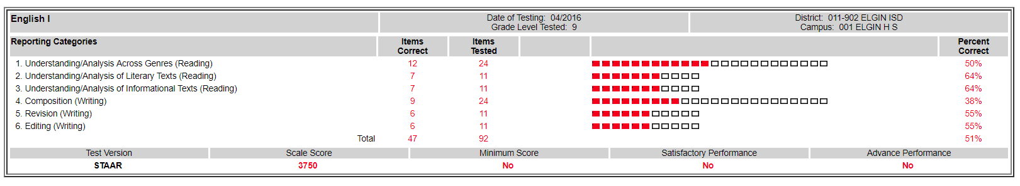
Scenario #6
In order for NGS to interpret the data, state assessment score and assessment interpretation MUST be entered in a specific way. How would you process the state assessment result shown below:
Assessment Type | Assessment Name | Assessment Score | Assessment Interpretation | Assessment Date | SSID | Grade Level
State Test – Math | STAAR EOC Algebra 1 | N/A | Absent | 05/03/2016 | TXEFGH | 9
Notes:
In order for NGS to interpret the data, state assessment score and assessment interpretation MUST be entered as follows: SCALE SCORE PASS/FAIL (e.g., 2280 Pass.

Slide 38
Scenario #6
In order for NGS to interpret the data, state assessment score and assessment interpretation MUST be entered as follows: SCALE SCORE PASS/FAIL (e.g., 2280 Pass.)
Assessment Type | Assessment Name | Assessment Score | Assessment Interpretation | Assessment Date | SSID | Grade Level
State Test – Math | STAAR EOC Algebra 1 | N/A | Absent | 05/03/2016 | TXEFGH | 9
State Test – English | STAAR EOC English 1 | 3750 | Fail | 04/01/2016 | TXEFGH | 9
Notes:
In order for NGS to interpret the data, state assessment score and assessment interpretation MUST be entered as follows: SCALE SCORE PASS/FAIL (e.g., 2280 Pass.

Slide 39

LET’S TALK
We encourage participants to ask questions or share final thoughts.

Slide 40

Thank you!
MELBA D. GARZA
Help Desk Manager |Long Tech Services, Inc.
512.474.4891
mdgarza@ngsmigrant.com
ESMERALDA SOLANO
ESC Region 20
esmer.solano@esc20.net
JOSÉ GÜERECA
South San Antonio ISD
jaguereca@southsanisd.net
AMET Conference | South Padre Island Convention Center | November 7-9, 2018

